Slide 1

Age and Gender Detection
Ajit Barman
Siliguri Institute of Thechnology, Darjeeling
West Bengal - India

Slide 2
ABSTRACT
The detection is the technique in which various factors are recognized on the basis of input and according to requirements. The age and gender detection is the issue which take consideration of researchers from last few years. In the topic on age and gender detection various techniques has been proposed to analysis features of the input image and on the basis of image features gender and approximation of age is defined. In this work, novel technique is proposed which is based on SIFT and morphological algorithm for age and gender detection. The morphological technique scan the input image and SIFT algorithm detect key features. The simulation is performed in MATLAB and it is been analyzed that proposed technique performs well in terms of fault detection rate and accuracy.
Keywords:- Detection, SIFT, Morphological, key features
ACKNOWLEDGEMENT
Success of any project or seminar report depends largely on the encouragement and guidelines of many others. I take this sincere opportunity to express my gratitude to the people who have been instrumental in the successful completion of this seminar work.
I would like to show our greatest appreciation to Mr. Asit Barman, Asst. Prof at SILIGURI INSTITUTE OF TECHNOLOGY, Darjeeling. I always feel motivated and encouraged every time by his valuable advice and constant inspiration; without his encouragement and guidance this Seminar report would not have materialized.
I am also copied some article from some website, some doc. Paper, pdf, book, etc.

Slide 3
I. INTRODUCTION
The enhancing of raw images that are received from the camera sources, from
satellites, aircrafts and the pictures captured in day-to-day lives is called image
processing. The images have been processed through many different
techniques and calculations have been made on the basis and analysis of the
studies. There is a need of analyzing and studying the digitally formed images.
There are two main and very common steps followed for image processing. The
improvement of an image such that the resulted image is of greater quality and
can be used by other programs, is called image enhancement [1]. The other
technique is the most sought after technique used for extraction of information
from an image. There is a division of the image into certain number of parts or
objects so that the problem is solved. This process is called segmentation.
II. LITERATURE REVIEW
Yunjo Lee, et.al proposed in this paper [7], that the fMRI method is used to study upon age detection methods. The study involves a proper recording of the variations of people on the basis of their changes according to age, gender, identity and other features. The brain activation tasks related to face matching are performed and tested outside the scanner. There was a same result in face processing in older as well as young adults. The performance results high in both the cases having same facial viewpoints.

Slide 4
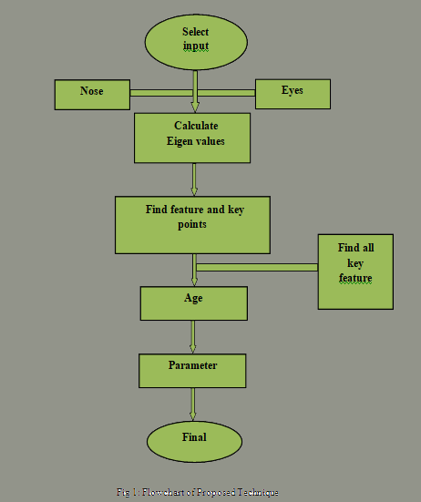
III. PROPOSED METHODOLOGY
Age estimation shares many problems encountered in other typical face image
interpretation tasks such as face detection, face recognition, expression and
gender recognition. A procedure which includes specific techniques is used.
Eigen Values: For a square matrix A of order n, the number is an Eigen value if and only if there exists a non-zero vector C such that AC=λC.

Slide 5
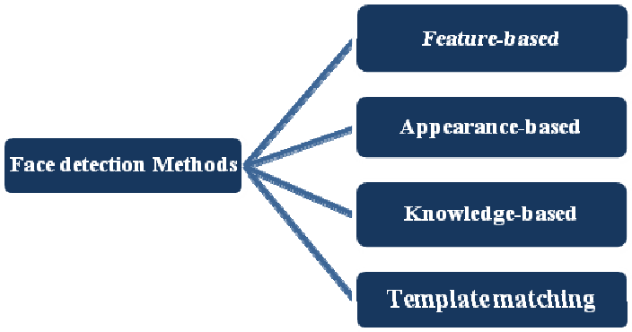
Face Detection Methods:-
Yan, Kriegman, and Ahuja presented a classification for face detection methods. These methods divided into four categories, and the face detection algorithms could belong to two or more groups. These categories are as follows-

Slide 6
1.Knowledge-Based:-
The knowledge-based method depends on the set of rules, and it is based on human knowledge to detect the faces. Ex- A face must have a nose, eyes, and mouth within certain distances and positions with each other. The big problem with these methods is the difficulty in building an appropriate set of rules. There could be many false positive if the rules were too general or too detailed. This approach alone is insufficient and unable to find many faces in multiple images.
2.Feature-Based:-
The feature-based method is to locate faces by extracting structural features of the face. It is first trained as a classifier and then used to differentiate between facial and non-facial regions. The idea is to overcome the limits of our instinctive knowledge of faces. This approach divided into several steps and even photos with many faces they report a success rate of 94%.

Slide 7
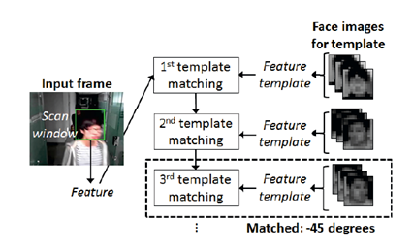
3.Template Matching:-
Template Matching method uses pre-defined or parameterised face templates to locate or detect the faces by the correlation between the templates and input images. Ex- a human face can be divided into eyes, face contour, nose, and mouth. Also, a face model can be built by edges just by using edge detection method. This approach is simple to implement, but it is inadequate for face detection. However, deformable templates have been proposed to deal with these problems.
Fig. Template Matching

Slide 8
4.Appearance-Based:-
The appearance-based method depends on a set of delegate training face images to find out face models. The appearance-based approach is better than other ways of performance. In general appearance-based method rely on techniques from statistical analysis and machine learning to find the relevant characteristics of face images. This method also used in feature extraction for face recognition.
The appearance-based model further divided into sub-methods for the use of face detection which are as follows-
4.1.Eigenface-Based:-
Eigenface based algorithm used for Face Recognition, and it is a method for efficiently representing faces using Principal Component Analysis.
4.2.Distribution-Based:-
The algorithms like PCA and Fisher’s Discriminant can be used to define the subspace representing facial patterns. There is a trained classifier, which correctly identifies instances of the target pattern class from the background image patterns.
4.3.Neural-Networks:-
Many detection problems like object detection, face detection, emotion detection, and face recognition, etc. have been faced successfully by Neural Networks.
4.4.Support Vector Machine:-
Support Vector Machines are linear classifiers that maximise the margin between the decision hyperplane and the examples in the training set. Osuna et al. first applied this classifier to face detection.

Slide 9
4.5.Sparse Network of Winnows:-
They defined a sparse network of two linear units or target nodes; one represents face patterns and other for the non-face patterns. It is less time consuming and efficient.
4.6.Naive Bayes Classifiers:-
They computed the probability of a face to be present in the picture by counting the frequency of occurrence of a series of the pattern over the training images. The classifier captured the joint statistics of local appearance and position of the faces.
4.7.Hidden Markov Model:-
The states of the model would be the facial features, which usually described as strips of pixels. HMM’s commonly used along with other methods to build detection algorithms.
4.8.Information Theoretical Approach:-
Markov Random Fields (MRF) can use for face pattern and correlated features. The Markov process maximises the discrimination between classes using Kullback-Leibler divergence. Therefore this method can be used in Face Detection.
4.9.Inductive Learning:-
This approach has been used to detect faces. Algorithms like Quinlan’s C4.5 or Mitchell’s FIND-S used for this purpose.

Slide 10
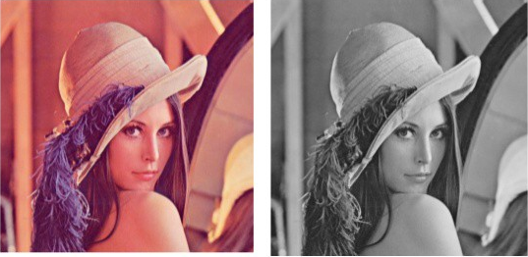
How the Face Detection Works:-
There are many techniques to detect faces, with the help of these techniques, we can identify faces with higher accuracy. These techniques have an almost same procedure for Face Detection such as OpenCV, Neural Networks, Matlab, etc. The face detection work as to detect multiple faces in an image. Here we work on OpenCV for Face Detection, and there are some steps that how face detection operates, which are as follows-
Firstly the image is imported by providing the location of the image. Then the picture is transformed from RGB to Grayscale because it is easy to detect faces in the grayscale.
Fig. Converting RGB image to Grayscale
After that, the image manipulation used, in which the resizing, cropping, blurring and sharpening of the images done if needed. The next step is image segmentation, which is used for contour detection or segments the multiple objects in a single image so that the classifier can quickly detect the objects and faces in the picture.

Slide 11
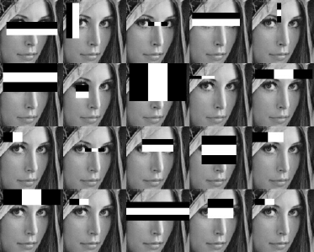
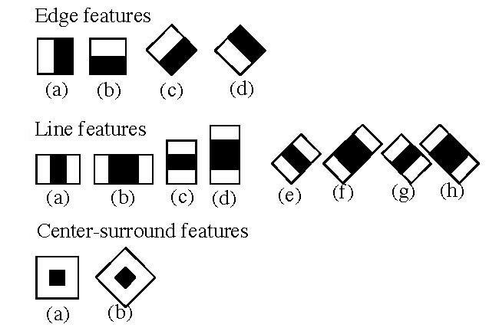
The next step is to use Haar-Like features algorithm, which is proposed by Voila and Jones for face detection. This algorithm used for finding the location of the human faces in a frame or image. All human faces shares some universal properties of the human face like the eyes region is darker than its neighbour pixels and nose region is brighter than eye region.
Fig. Haar-like features for face detection
The haar-like algorithm is also used for feature selection or feature extraction for an object in an image, with the help of edge detection, line detection, centre detection for detecting eyes, nose, mouth, etc. in the picture. It is used to select the essential features in an image and extract these features for face detection.

Slide 12
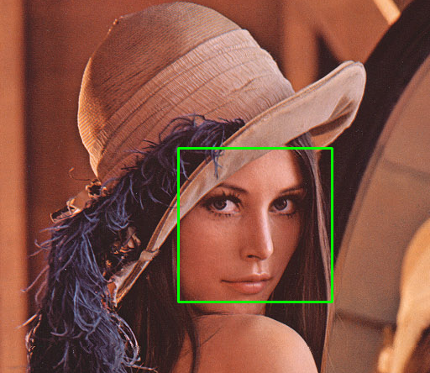
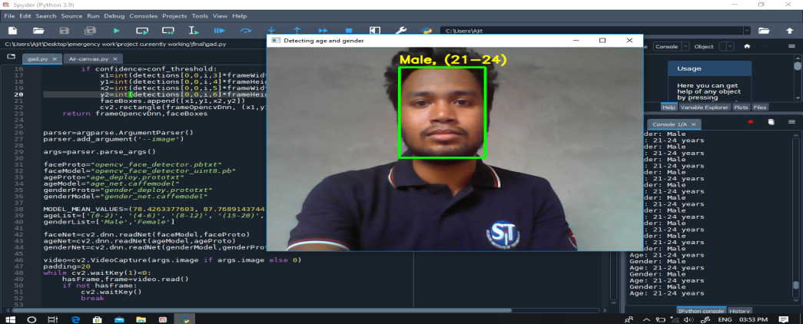
The next step is to give the coordinates of x, y, w, h which makes a rectangle box in the picture to show the location of the face or we can say that to show the region of interest in the image. After this, it can make a rectangle box in the area of interest where it detects the face. There are also many other detection techniques that are used together for detection such as smile detection, eye detection, blink detection, etc.
Fig. Successfully detect the face in an image
*So,we can detection age & gender by this face detect technique

Slide 13
CONCLUSION
In this work, it is been concluded that detection of age and gender take consideration of research few years ago. In this work, technique of morphological and SIFT is applied to search key features from the images. The key features of the images are the color and texture of the image. The simulation results shows that proposed algorithm performed well in terms of fault detection rate and accuracy. In future, further improvement will be done in proposed work for iris reorganization for batter reorganization.
REFERENCES
[1]. A. Kumar and F. Shaik,” Importance of Image Processing”, 2016
[2]. Chenjing Yan, Congyan Lang, Tao Wang, Xuetao Du, and Chen Zhang,” Age Estimation Based
on Convolutional Neural Network”, 2014 Springer International Publishing Switzerland
[3]. Aditya K. Saxena, Shweta Sharma and Vijay K. Chaurasiya,” Neural Network based Human
Age-group Estimation in Curvelet Domain”, 2015 The Authors Published by Elsevier B.V.
[4]. Dong Yi (B), Zhen Lei, and Stan Z. Li,” Age Estimation by Multi-scale Convolutional Network”,
2015 Springer International Publishing Switzerland

Slide 14
[5]. A. Ultsch, G. Guimaraes, D. Korus, H. Li,” Knowledge Extraction from Artificial Neural Networks and
Applications”, 1993 Springer
[6]. Eran Eidinger, Roee Enbar, and Tal Hassner,” Age and Gender Estimation of Unfiltered
Faces”, 2014 IEEE
[7]. Yunjo Lee, Cheryl L. Grady, Claudine Habak, Hugh R. Wilson, and Morris Moscovitch,” Face
Processing Changes in Normal Aging Revealed by fMRI Adaptation”, 2011 Massachusetts Institute of
Technology
[8]. R. Begg1 and J. Kamruzzaman,” Neural networks for detection and classification of walking pattern
changes due to ageing”, 2006 ACPSEM/EA
[9]. Hang Qi and Liqing Zhang,” Age Classification System with ICA Based Local Facial Features”, 2009
Springer-Verlag Berlin Heidelberg
Website:
https://quick-adviser.com/
https://data-flair.training/
https://towardsdatascience.com/
https://learnopencv.com/
https://www.ris-ai.com/

